Slide 1
Analyzing Health Equity Using Household Survey Data
Lecture 11
Nonlinear Models for Health and Medical Expenditure Data
Notes:
Heath sector variables are seldom continuous and fully observed. For example, they can be discrete (e.g., death), censored (e.g., health care expenditure), integer counts (e.g., visits to doctor), or durational (e.g., time to death). Multivariate analysis of such dependent variables requires nonlinear estimation. In this lecture, we consider the main (parametric) nonlinear estimators that are of relevance to the analysis of health sector inequalities. The literature is extensive, and our coverage is necessarily rudimentary, with a focus on practicalities rather than theory.

Slide 2
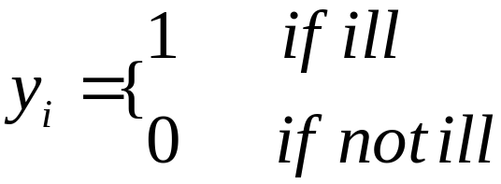


Binary dependent variables
In general,
→ Linear probability model (LPM)
OLS estimation of LPM:
Consistent only if has a zero prob. of lying
outside (0,1)
- inefficient (error non-normal and heteroskedastic)
- predicted probability not constrained to (0,1)
Notes:
There are numerous examples of health sector variables that take only two values—dead/alive, ill/not ill, stunted/not stunted, goes to doctor/doesn’t go to doctor, and so on. In some cases, there are only two possible values of the underlying characteristic, for example, dead/alive. In other cases, the underlying characteristic is continuous, for example, degrees of illness, but only two categories are observable in the data—ill/not ill.
Note it is often claimed that OLS is consistent for the LPM. Horrace and Oaxaca (2006) demonstrate that this is true only under the stated condition, which can be strong.
The heteroscedasticity problem could be dealt with by using weighted least squares.
E[] denotes expectations and Pr() probability

Slide 3




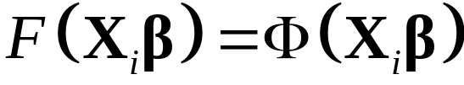
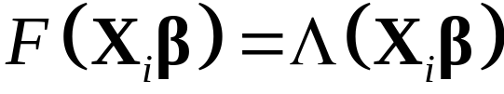
Latent variable model
Let a latent index
indicate illness propensity
Specify,
If
~ standard normal, then
is standard normal cdf → Probit model.
If
~ standard logistic, then
is the standard logistic cdf → Logit model.
Notes:
An obvious, and common, response to these problems with OLS is to choose some functional form for F() that constrains estimated probabilities to lie in the (0,1) range. The two most popular choices are the cumulative standard normal distribution, which gives the probit model, and the cumulative standard logistic distribution, which gives the logit model.
Thinking about binary responses being driven by some underlying but unobservable (latent) characteristic helps to motivate such models. For example, let y* indicate propensity to contract illness. When this crosses some threshold, say y*>0, the individual is ill. Specifying the latent variable to be a linear function of observable and unobservable factors, y*=Xb+e , and choosing a distribution for the error term as either standard normal or logistic gives the probit and logit models. Estimation is carried out by maximum likelihood.

Slide 4
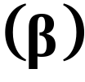

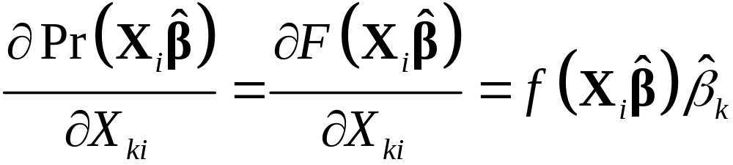
Interpretation of probit/logit estimates
- Parameters only identified up to scalar factor equal to
(non-estimable) std. dev. of error.
- Multiply logit coeff. by 0.625 to compare with probit.
- Divide probit coeff. by 2.5 & logit by 4 to compare with LPM.
Parameters give impact on latent index.
Estimate of partial effect on given by:
Notes:
Because the normal and logistic distributions are similar, the choice of a probit or logit specification is not important in most cases.
Care must be taken not to compare probit and logit coefficients directly, however. In both cases, parameters are estimable only up to a scaling factor, equal to the unknown standard deviation of the error, which is not estimable given the binary nature of the dependent variable.
Only the relative, not the absolute, effect of explanatory variables are estimable. Because variances differ between the normal and logistic distributions, logit coefficients must be multiplied by 0.625 to be comparable with probit coefficients (Amemiya 1981). Dividing probit estimates by 2.5 and logit estimates by 4 will make them comparable with those from the LPM (Wooldridge 2002).
Further care must be taken in the interpretation of estimates from latent variable models. The (scaled) parameters give the (relative) partial effects on the latent index , but these effects are usually not of primary interest. The partial effects on the probability of possessing the characteristic are more informative. For example, an estimate of how the probability of being sick changes with income is more easily interpreted than an estimate of how a latent index of sickness propensity varies with income.

Slide 5
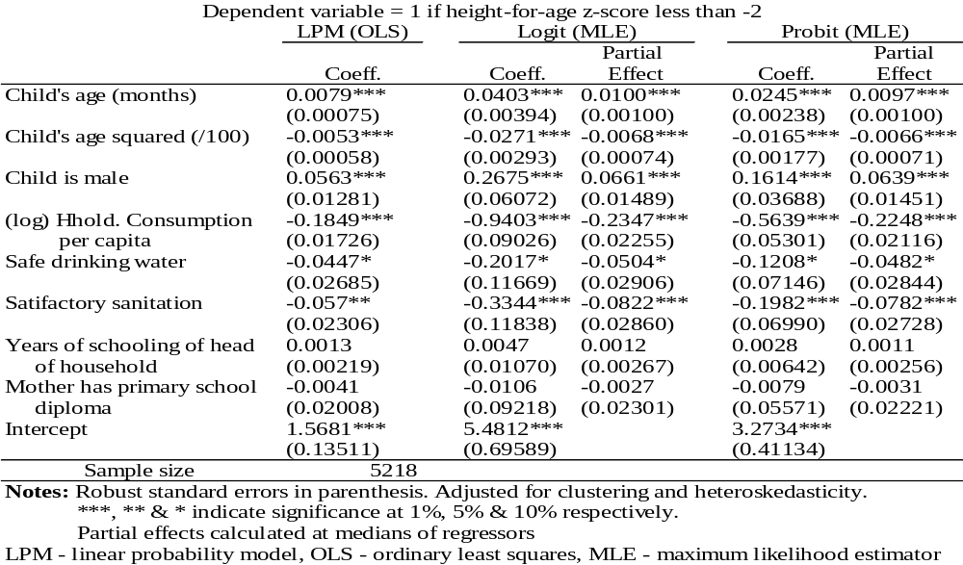
Estimates from Binary Response Models of Stunting, Vietnam 1998 (children <10 years)
Notes:
We compare the linear probability, logit, and probit models in estimating correlates of a discrete state of child malnutrition, defined as height-for-age more than two standard deviations below the average in a well-nourished (U.S.) population (see lecture 4 ). The data are for children younger than 10 years of age and are taken from the 1998 Vietnam Living Standards Survey (VLSS). This analysis complements that of a continuous measure of nutritional deprivation presented in the previous lecture.
In the table we present estimates of the parameters of the respective models. Standard errors are adjusted for the clustered nature of the sample and are robust to general heteroscedasticity (see lecture 10 ). No adjustment is made for stratification, and sample weights are not applied, it being assumed that stratification is on exogenous factors (see lecture 10).
There is a great deal of consistency across the estimators in the levels of significance of the coefficients. As suggested above, dividing logit and probit coefficients by 4 and 2.5, respectively, makes them approximately comparable to the LPM coefficients. For the coefficient on the male dummy, that gives 0.0669 (= 0.2675/4) for logit and 0.0646 (= 0.1614/2.5) for probit, which are both larger than the LPM coefficient of 0.0563. More directly, we can compare the partial effects of the regressors on the probability that a child is stunted. For the LPM, these marginal effects are given by the coefficients themselves and so are constants. For the logit and probit models, we have calculated the partial effects at the median values of the regressors. In general, the estimated partial effects from logit and probit are very close and are larger in magnitude than those from the LPM.

Slide 6
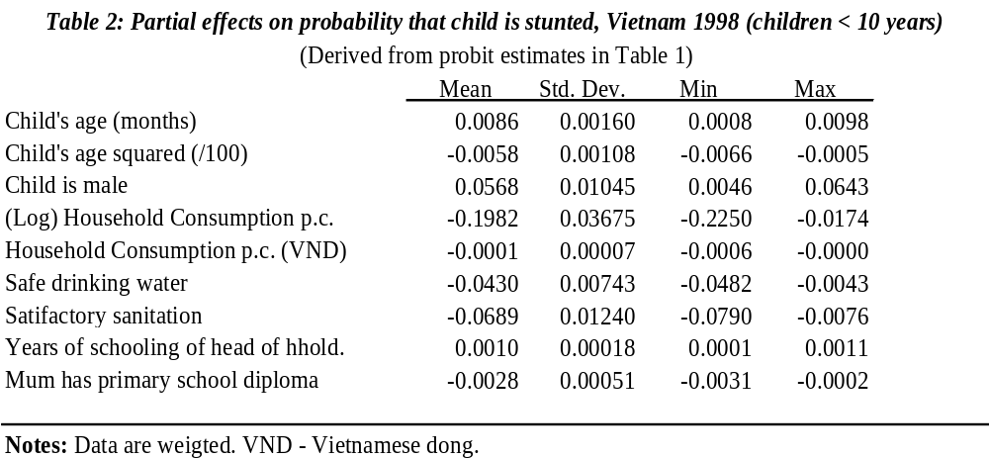
Distribution of partial effects
Notes:
In this table, we summarize the distributions of the partial effects estimated from the probit model. This form of presentation makes it clear that partial effects vary across individuals. For example, the mean effect of satisfactory sanitation is to reduce the probability of stunting by 0.0689, from an estimated population average probability of 0.3737. In absolute terms, the strongest partial effect of satisfactory sanitation is a reduction in the probability by 0.0790, but this is from a predicted baseline probability for that individual of 0.5281. The weakest absolute effect is a reduction in the probability of only 0.0076, but this is large in relation to the respective baseline probability of 0.0118.
Partial effects can be calculated with respect to variables of inherent interest, rather than transformations of these. For example, in the table, we present the partial effect of a currency unit increase in household consumption, as well as the effect of a marginal increase in the log of consumption. Partial effects of variables entered in quadratic form, such as age, can be calculated but are of limited interest. The partial effect of age itself is a function of the partial effects of the first and second powers of age (given in the table). This function can be calculated but, given the quadratic nature of the function, the partial effect changes sign. It is of more interest to examine a picture of the quadratic function and locate its turning point (six years and two months, in this example).

Slide 7
Limited dependent variables
A LDV is continuous over most of distribution but has mass of observations at one or more values.
Example – medical expenditures with mass at zero.
Alternative models – two-part, Tobit, sample selection, hurdle & finite mixture.
Concentrate here on modelling medical exp.
Notes:
A limited dependent variable is continuous over most of its distribution but has a mass of observations at one or more specific values, such as zero. The most important example in the health sector is medical expenditure, which is zero for many individuals over a survey recall period, such as 12 months. For example, in 1998 the average Vietnamese spent 153,000 Vietnamese dong (D) ($1 = 13,987D) out-of-pocket on medical care during a 12-month period, but 17 percent spent nothing at all.
There are a multitude of statistical approaches to modeling of a limited dependent variable—for example, the two-part model, the Tobit model, the sample selection model, hurdle models, and finite mixture models. For a comprehensive survey, see Wooldridge (2002). Here, we restrict attention to the most popular approaches to modeling medical expenditures. For an excellent survey of this literature, see Jones (2000). Equity analysis of medical expenditures may focus on their income elasticity, on variation in the price elasticity of health care with household income, on the responsiveness of medical expenditure to health shocks, or the extent to which this responsiveness is reduced by unequally distributed insurance coverage.

Slide 8






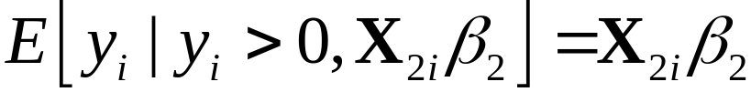
Two-part model (2PM)
- For example, probit for any expenditure and OLS for
non-zero expenditures.
- Central issue is sample selection bias.
Let an indicator of whether exp. is positive be determined by and
Let the level of exp. be determined by and
Consistency of OLS part of 2PM requires
(4)
Notes:
The most straightforward approach is the two-part model (2PM). In its most popular form, this comprises a probit (or logit) model for the probability that an individual makes any expenditure on health care and OLS, applied only to the subsample with nonzero expenditures, to estimate correlates of the positive level of expenditure. Given that typically the distribution of medical expenditures is right skewed, invariably the log of expenditure is modeled in the second part OLS.
Application of OLS to only part of the sample raises the possibility of sample selection bias. The issue has been the subject of a great deal of discussion (Jones 2000). In summary, consistency of the 2PM for the model parameters rests on strong assumptions. Nonetheless, if the aim is simply to predict conditional means and not to make inferences about individual parameters, then the 2PM may perform reasonably well (Duan et al. 1983). On that basis, the model will often be adequate for analysis of health sector inequalities, where we simply want to predict, for example, medical expenditure conditional on income, age, gender, and so on.
Condition (4) says that, conditional on expenditure being positive, the unobservable determinants of its log have zero mean. To justify the assumption, either unobservable factors that influence the positive level of expenditures must be independent of those governing the probability of a positive expenditure , or the two error terms must have some peculiar joint distribution that gives a conditional distribution centered around zero. The latter would be an extreme and nontestable assumption (Jones 2000). The former assumption can possibly be supported under certain decision-making processes, for example, if the individual decides whether to seek treatment without considering how much to spend during the course of treatment. That rules out the possibility that the individual decides not to seek care because of the anticipated cost of a course of treatment. In support of such a sequential model of decision making, it might be claimed that the patient delegates all treatment decisions to the doctor. Empirically, however, such a defense is weak because typically survey data span a period of calendar time and not the duration of an illness episode (Deb and Trivedi 1997). Even if it is accepted that medical care decisions are made in a sequential manner, correlation between unobservables would still arise in cases in which common variables are omitted from the two stages of the decision-making process (Jones 2000).

Slide 9
2PM contd.
Expected medical exp. given by
(5)
Problem when 2nd part is estimated in logs →
retransformation problem.
Then the assumption (4) not sufficient to
identify the prediction (5).
Notes:
1. For possible solutions to the retransformation problem, see Jones (2000) and Mullahy (1998). This rather weakens the argument that the 2PM is reasonable when one is interested only in estimating the conditional means.

Slide 10
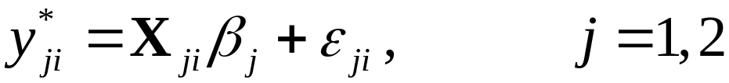
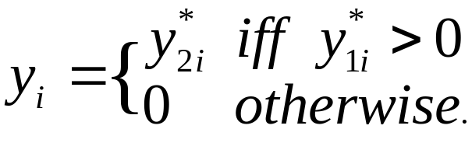
Sample selection model (SSM)
- 2PM assumes independence between decision to seek care
and decision of how much to seek.
SSM allows for dependence between these decisions.
SSM in latent variable form:
Notes:
1. The sample selection model (SSM), or generalized Tobit, can be considered, somewhat informally, to lie midway between the extremes of the Tobit and the 2PM. Whereas the Tobit assumes a single decision process and the 2PM two independent decisions, the SSM allows for two interdependent decisions. The decision to seek medical care and the choice of how much to spend can be influenced by distinct but correlated observable and unobservable factors.

Slide 11
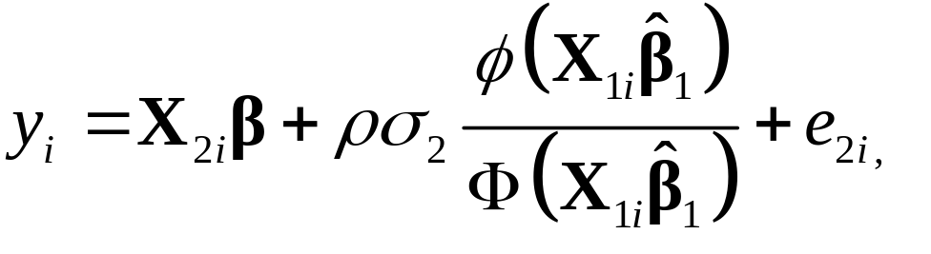

Estimation & identification of SSM
- If assume joint normality of the error terms, can estimate
by 2-step Heckman or Maximum Likelihood.
- 2-step Heckman is probit plus OLS of,
- Selection bias tested by t-statistic on Inverse Mill’s Ratio
- Identification:
- Non-linearity of IMR?
- Exclusion restriction on ?
Notes:
Although the SSM is, in an informal sense, more general, this comes at the cost of making greater demands on the data with respect to identification. Given the nonlinearity of the IMR, the equation above is identified even if the regressor matrices and are identical, but in this case the Mill’s ratio will be closely correlated with the other regressors and, consequently, parameters will not be estimated with precision. It is therefore preferable to have a variable that influences the decision of whether to spend anything on health care but, conditional on this, does not influence the positive level of expenditure. Such variables, however, are few and far between.
The Tobit and 2PM avoid this problem but only by assumption. The bottom line is that it is difficult to make an a priori case for any one model of medical expenditures. One should probably be most skeptical of the Tobit model and its assumption of a single decision process driving both zero and positive expenditures. In choosing between the 2PM and the SSM, it is necessary to consider the purpose of the analysis (prediction or parameter estimation), the likely degree of selection bias, and the information available to identify it.

Slide 12
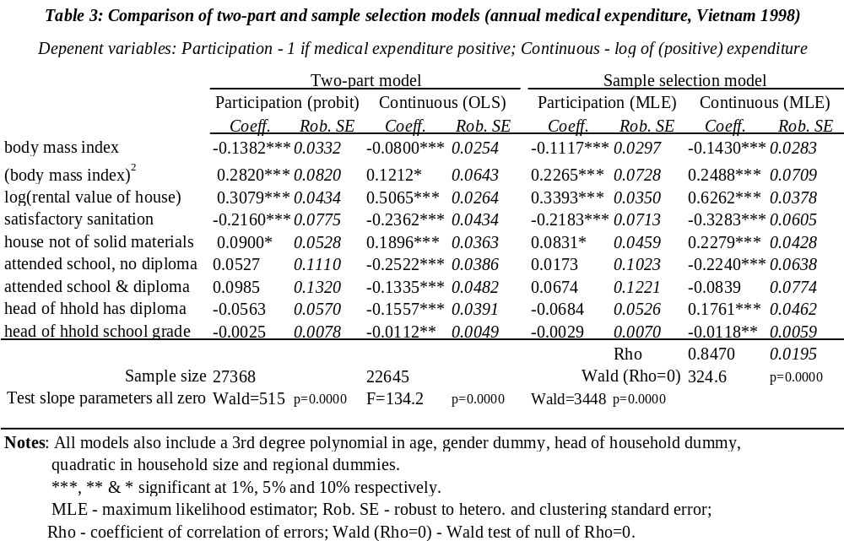
OOP payments in Vietnam
Notes:
We examine correlates of annual out-of-pocket expenditures on health care in Vietnam. We use data from the 1998 VLSS. Almost one-fifth (18%) of the observations made no expenditures on medical care. In addition to this mass at zero expenditure, the distribution has a long right tail. Given such skewness, one would expect a log transformation of the dependent variable to be appropriate, and the results confirm this. We make two comparisons, the 2PM with the SSM taking logs of positive expenditures in each case and the 2PM with the Tobit leaving the dependent variable in levels (see the table below).
Results from the maximum likelihood estimator of the SSM are given. These do not differ substantially from estimates obtained using the Heckman two-step procedure. Estimates of the coefficients of the selection equation display no substantial differences across the estimators. There are no differences in levels of significance. Coefficient estimates for the continuous parts of the models do show some differences, with those from the SSM generally of greater magnitude. There are some differences in levels of significance.
There is a positive and large degree of correlation between the two equation errors (0.847). The null of no correlation, and therefore no selection bias, is firmly rejected. In the absence of any variable that can plausibly be argued to affect the probability of positive expenditure but not its level, the correlation parameter is being identified through functional form alone. Graphical analysis confirms that, in this case, the inverse Mill’s ratio is sufficiently nonlinear in its argument to avoid severe collinearity problems.

Slide 13
Count dependent variables
A count can take only non-negative integer values, y=0,1,2,3,….
Typically right-skewed with mass at 0
Discrete nature of variable and shape of distribution require particular estimators
Notes:
1. Many of the variables of interest in the health sector are nonnegative counts of events. For example, visits to the doctor, drugs dispensed, days ill, and so on. A count is a variable that can take only integer-values. Often, as with most health count variables, negative values are not possible. Typically, the distribution of such variables tends to be right skewed, often comprising a large proportion of zeros and a long right-hand tail. The discrete nature of a nonnegative count dependent variable and the shape of its distribution demand the use of particular estimators. For example, least squares would not guarantee that predicted values are nonnegative.

Slide 14
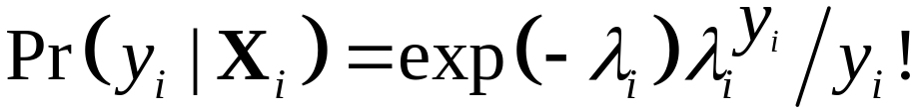
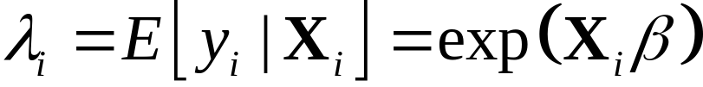

Poisson model
(12)
(13)
with (often),
- Poisson distribution characterised by one parameter,
, imposing equality of conditional mean and variance.
In health applications, is often overdispersion.
Consequence can be under-prediction of zeros.
Notes:
y! denotes y factorial.
A peculiarity of the Poisson distribution is that its mean and its variance are both equal to its one parameter, . This is often restrictive. In health applications, for example, the conditional mean is usually less than the conditional variance. In jargon, there is overdispersion. One consequence can be underprediction of the number of observations with zero counts; again, an empirical feature of many health care applications.

Slide 15
Negative binomial model
Can impose overdispersion thru’ choice of distribution.
NegBin: maintain (12) but add error term with gamma
distribution to (13).
NegBin I: variance proportional to mean.
NegBin II: variance quadratic function of mean.
Can also specify dispersion as a function of regressors.
“Excess zeros” may also reflect a distinct decision process.
2-part count model: probit/logit for 0,1 and
    truncated Poisson/NegBin for 1,2,3,…
Notes:
Overdispersion can be allowed for, or rather imposed, through alternative distributional assumptions. For example, a negative binomial specification maintains the Poisson process (equation 11.12) but extends equation 11.13 to include an error term, for which a (gamma) distribution is assumed. As a result, the (conditional) variance of the count is restricted to be greater than its mean (Cameron and Trivedi 1986). The difference between the variance and mean, that is, the dispersion, can be specified as proportional to the mean (NegBin I) or a quadratic function of the mean (NegBin II) (Cameron and Trivedi 1986). The model can be further generalized by allowing the dispersion to vary across observations with a set of regressors.
Overdispersion is not the only reason a simple Poisson model may underpredict the number of zero counts. There may be a particular process responsible for generating zeros that is distinct from that generating other values of the count variable. One possibility, in the context of health care utilization, is a sequential decision-making process, as discussed in the previous section. This takes us back to the 2PM. In a count framework, the 2PM consists of a probit/logit (or Poisson/NegBin) to model the probability of a nonzero count followed by a count regression, such as Poisson or NegBin, applied to observations with positive counts only and allowing for the truncation at zero (Pohlmeier and Ulrich 1995). Independence is assumed between the two processes. Other possibilities are “zero-inflated” models and latent class models (Jones 2000, 318–24).

Slide 16
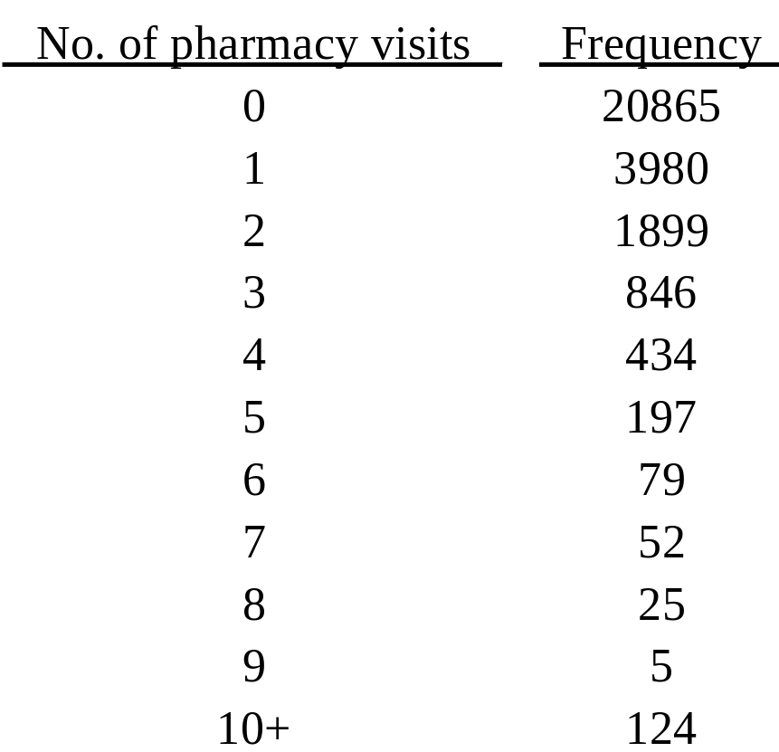
Pharmacy visits in Vietnam
Notes:
Annual visits to a pharmacy or drug peddler in Vietnam provides a good example of a distribution suited to the application of count data models. That is, there are a large number of zeros and a long right tail.
It should be acknowledged that we chose this distribution on the basis of its suitability for count analysis. With many count variables encountered in health applications, the dominance of zero values is much greater than in this example and the best option is simply to dichotomize the variable and use probit or logit to model the probability of a nonzero count.

Slide 17
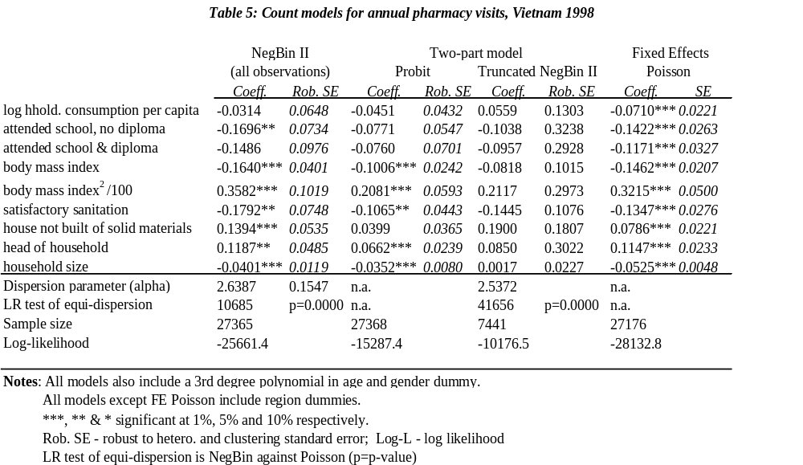
Pharmacy visits- count models
Notes:
Estimates and robust standard errors from a NegBin II model of pharmacy visits are given in the first two columns of the following table. NegBin II was chosen over NegBin I by comparison of the log-likelihood values. There is strong evidence of overdispersion as indicated by the magnitude of the dispersion parameter and the LR test, which decisively rejects the Poisson (equi-dispersion) specification.
Moving to a 2PM, there is some loss of significance, with significant effects in the first stage probit only. Restricting the count regression to positive values is not sufficient to remove overdispersion—a Poisson specification is still strongly rejected. Finally, we estimate a fixed-effects Poisson on all observations. The fixed effects are those of 194 communes. Point estimates from the FE Poisson are somewhat similar to those from NegBin II on the full sample, but there are large differences in levels of significance for some interesting variables. In particular, the household consumption effect becomes strongly significant. Apparently, the commune effects had initially confounded this (negative) income effect.

